Slide 1
2023 DANVILLE NH BUILDING COMMITTEE
COMMITTEE SUMMARY
July 17, 2023

Slide 2
2023 DANVILLE NH BUILDING COMMITTEE
References
Danville PD Meeting 6-27-23
Charters Brothers Meeting 7-14-23
Charters Brothers 2020 PD Project summary

Slide 3
2023 DANVILLE NH BUILDING COMMITTEE
2019 DANVILLE NH POPULATION STUDY
Conducted by:
Town of Danville NH
Rockingham Planning Commission (RPC)
2019 Population: 4,479
Estimated Maximum Growth: 7,500 – 9,000 (No Time Frame)
2019 POLICE DEPARTMENT STAFFING CALCULATION
1 to 1.5 police officers per 1,000 residents
Considerations:
Crime Rate
Traffic
Neighboring Communities
Mutual Aid Assistance
2023 DANVILLE NH POLICE DEPARTMENT STAFFING
8 Full time, 2 Part Time
3 – First Shift
2 –Second Shift
1 – Third Shift
Shift Coverage May Vary

Slide 4
2023 DANVILLE NH BUILDING COMMITTEE
CRITERIA CONSIDERATIONS
Town Owned Property
Commercial Property (1)
Building Retrofit (1)
Location
Terrain
Structure Type, Layout
Cost Factors

Slide 5
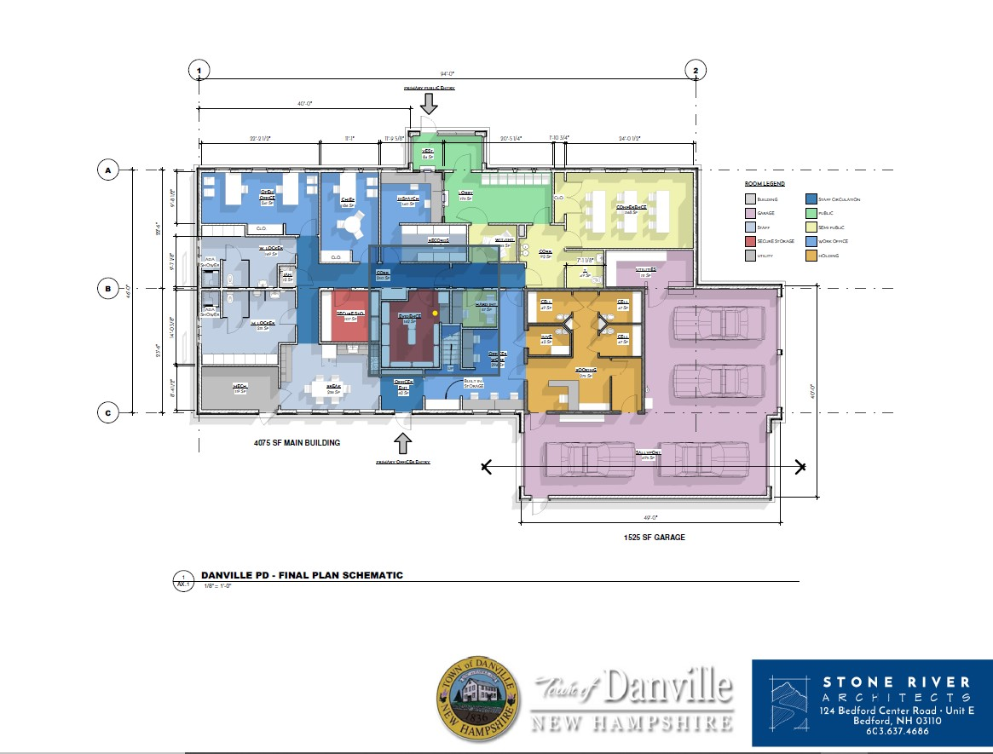
2023 DANVILLE NH BUILDING COMMITTEE
Hersey Rd Floor Plan

Slide 6
2023 DANVILLE NH BUILDING COMMITTEE
Building Cost Trends Year Over Year
25% Building Cost Increases Since 2020
Avg. 6% to 7% Increase Per Year
Trend May Continue Over Next 5Yrs

Slide 7
2023 DANVILLE NH BUILDING COMMITTEE
Funding
PD Capital Reserve: $527,139.26
State/Federal: TBD
Other: TBD
Taxes

Slide 8
2023 DANVILLE NH BUILDING COMMITTEE
Next Steps: August Meeting
Building Layout Update
Cost Estimates
Location Evaluation/Recommendations

