Slide 1
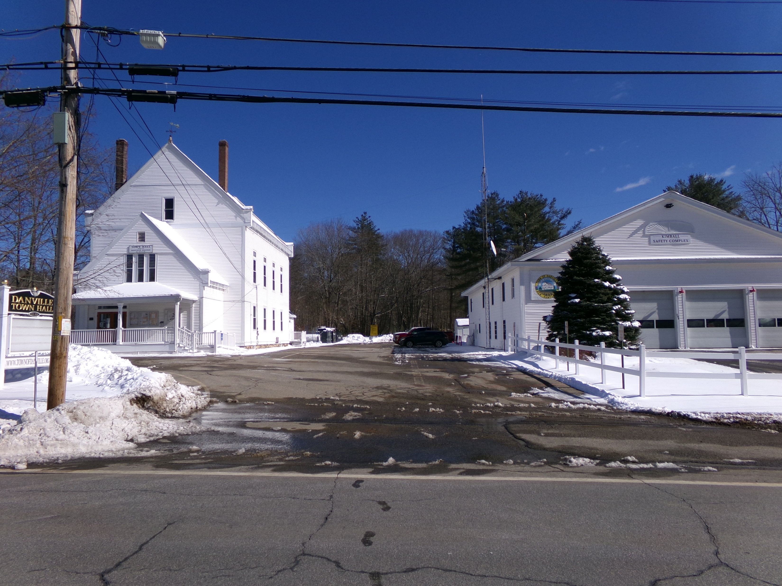
210 Main St

Slide 5
Advantages
Two Problems – One Solution
Central Location for PD
One-stop shopping for residents

Slide 6
Disadvantages
Cost
Parking

Slide 7
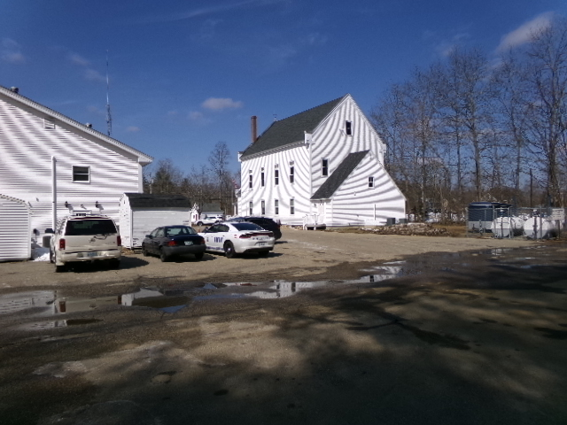

Slide 8
